Slide 1
Windows Virtual Desktop Lighthouse Program
Partner Guide
September 2019

Slide 2
Windows Virtual Desktop presents opportunities with 3 Sales Scenarios
Replace/Migrate on-prem virtual desktop deployments
New Windows
Virtualization
Manage Win 7 End of Support with WVD
Migrate workloads to cloud for flexibility and cost savings
Reduce management complexity and enhance security
Modernize infrastructure
Provide modern, consistent, and secure Windows 10 user experience at low cost
Continue running Win7 apps, while modernizing your PC footprint

Slide 3


Replace/Migrate on-prem virtual desktop deployments
Customer Situation
Customer Benefits
Next Steps
Target customer:
Enterprise customers running Windows Server RDSH on-prem
Triggers:
Cloud migration/DC consolidation
Geo expansion
Rapid customer growth
Approaching HW asset refresh
Azure Cloud efficiency and flexibility
Superior Economics Windows Server VMs charged at Linux rate RDS CAL savings with Windows 10 Multi-Session deployment
Simplified Management Management service included with the licenses you already own One service for both desktop and RemoteApp
Enhanced security Azure AD integration, reverse connect technology, and role-based access control
Gather customer’s Windows Server RDSH licensing position, including WS License and RDS CAL
Explain to customer challenges with on-prem solutions:
High cost and inflexibility associated with upfront Capex commitment, Windows Server VMs deployment, managing underlying infrastructure and requirement of RDS CAL
Separate services for desktop and app virtualization increase management complexity
High effort to setup, configure, and monitor security
Use Solution Configurator tool to estimate WVD economics benefits
Evaluate Solution Definition: (WS-based or Win 10 Multi Session) and choice of management plane
Learn about Lighthouse Program benefits and resources
WINDOWS SERVER LICENSE
File Server VMs
WINDOWS SERVER LICENSE
File Server VMs
License Server VMs
License Server VMs
RDSH VMs
RDSH VMs
Notes:
(Win7-specific benefit)
If you are using Win7 today, the support for Win7 will end in January 2020, and it’ll incur additional cost if you wish to continue to get extended security updates after that. Depending on calendar year and your Win7 license tier, the cost per device per year can be up to $200. However, with WVD, 3-year Win7 ESU is already included. In other words, it can save you up to $200 per device per year if you move to WVD.
Note: this benefit applies to Win 7 VMs running in WVD on Azure, not applicable to Win 7 running on local devices

Slide 4
New Windows Virtualization
Customer Situation
Customer Benefits
Next Steps
Target customer:
Flexible workforce, e.g. contractor & partner access, short-term employees, BYOD
Heavy users of Office 365 ProPlus
Existing Azure customers
Triggers:
BYOD and mobile
Contractor and partner access
Short term employees
Best User Experience Optimized Office 365 ProPlus in virtual environment
Superior Economics The only way to deliver Windows 10 multi-session with native user experience and low cost
Understand customer current situation
Explain to customer the tradeoff between user experience and cost effectiveness
Use Solution Configurator tool to estimate WVD economics benefits
Evaluate Solution Definition, including the choice of management plane: (WVD Native, Citrix+WVD or VMWare+WVD)
Learn about Lighthouse Program benefits and resources
Run Windows 10 single session on-prem
Achieve same Win 10 experience at MS cost
…
…
1 user to 1 smaller VM with low utilization
Utilization
Many users per 1 larger VM with high utilization and lower operational costs

Slide 5


Manage Windows 7 End of Support with WVD
Customer Situation
Customer Benefits
Next Steps
Target customer:
Existing legacy Win 7 SW
Roadblocks to Win10 modernization
Triggers:
Existing legacy Win 7 SW
Roadblocks to Win10 modernization
ESU costs:
Superior Economics
Migrate Win 7 desktops and modernize to Win 10 with 3-year ESU included
Strong Partner Ecosystem
Modernize Win 7 apps and upgrade to Win 10 at your own pace and with help of experienced partners
Understand customer current situation
Explain to customer the ESU costs and learn about the incompatible apps
Use Solution Configurator tool to estimate WVD economics benefits
Evaluate Solution Definition, including the choice of management plane: (WVD Native, Citrix+WVD or VMWare+WVD)
Learn about Lighthouse Program benefits and resources
Ask your customers, “What’s your Windows 7 plan?”
Year | 2020 | 2021 | 2022
ESU Cost | $25 | $50 | $100
WVD
WVD
Applications
Applications
Applications
Win10 Compat
Win10 Compat
Win 7
Win10 Compat
Win10 Compat
Win 7
Win10 Compat
Win10 Compat
Win10 Compat
On-prem physical / VDI
Notes:
(Win7-specific benefit)
If you are using Win7 today, the support for Win7 will end in January 2020, and it’ll incur additional cost if you wish to continue to get extended security updates after that. Depending on calendar year and your Win7 license tier, the cost per device per year can be up to $200. However, with WVD, 3-year Win7 ESU is already included. In other words, it can save you up to $200 per device per year if you move to WVD.
Note: this benefit applies to Win 7 VMs running in WVD on Azure, not applicable to Win 7 running on local devices

Slide 6


Select from WVD Native, Citrix Cloud+WVD and VMWare+WVD based on customer situation
Solution Choices
Dictated by Customer Needs
Citrix and VMware provide value add to WVD (e.g. hybrid deployment management)
Windows 10 Multi-Session, Win 7 with included ESU for 3 years, Linux rates on WS VMs are also available with Citrix & VMware, management plane
Customer ultimately decides the management plane(s) of choice based on their business and technical needs
WVD Native
+ WVD
+ WVD

Slide 7
WVD Lighthouse Program: help Partners on their customers’ journey
Purpose | Customer Success Criteria | MSFT Gives | Customer Gives
Build pipeline of qualified customers | Active engagement: MSX ID (WVD tag) | $250 Azure credits (valid for 2 months) Access to WVD Lighthouse Program technical forum | Enrollment into LH Program (Trial Phase) MSX engagement ID with WVD tag (created by MSFT Field Sales Lead)
Drive to a minimally viable production solution to prove WVD’s business and technical feasibility to your Customer | 25+ monthly active users (MAU) in production: ~3 months | Up to $3,000 Azure credits (valid for 3 months) Up to $30,000 customer incentives Access to assessment and migration acceleration tools: Lakeside, Liquidware, Citrix Cloud, Nerdio and Cloudjumper Access to WVD Design and Deployment Helpdesk Access to WVD Lighthouse Program technical forum | Enrollment into LH Program (Production Pilot Phase) MSX engagement ID with WVD tag Commitment to Success Criteria as documented in signed Deployment SOW with Partner
Deploy a scalable solution in your Customer’s production environment Customer must have a MAU > 25 to qualify for this phase | 500+ MAU in production: before June 15, 2020 | Up to $20,000 Azure credits (valid for 6 months – all credits will expire on June 30, 2020) Up to $60,000 incentives Access to assessment and migration acceleration tools: Lakeside, Liquidware, Citrix Cloud, Nerdio and Cloudjumper Access to WVD Design and Deployment Helpdesk WVD Global Blackbelt resource support Escalations to engineering team Early WVD product roadmap visibility Executive sponsorship within Microsoft | Enrollment into LH Program (Scale Phase) MSX engagement ID with WVD tag Commitment to Success Criteria as documented in signed Deployment SOW with Partner
Trial
Production Pilot
Scale

Slide 8
WVD Lighthouse Program Checklist for Partners & Process Summary
Trial
Use WVD Product Qualification Checklist to help customer make decision on Management plane
For strategic engagements, leverage local Microsoft’s WVD GBB team and other resources as appropriate
Leverage key resources including Solution Configurator tool, customer discussion guide, WVD technical FAQ. Pointer to WVD Azure docs, product checklist
Production Pilot
Work with customer to define scope of project. Review WVD design and deployment guide as reference
Check for Production Pilot criteria (25+ MAU in production) as part of SOW
Work with Microsoft Seller to secure Production Pilot incentive funds
Scale
Check for Scale criteria (500+ MAU in production) as part of SOW
Work with Microsoft Seller to secure Scale incentive funds
Process Summary
Engage Customer
Build SOW
Submit to Lighthouse Program

Slide 9
WVD Lighthouse Program: High Level Workflow
Target Customers & Pitch WVD
Evaluate Solution Definition
Have Microsoft Seller submit nomination on LH program site
Run Trial
Work with Microsoft Seller to ensure program benefits are allocated to Customer
Trial
START*
Qualify Customer for Production Pilot
Ensure scope & success metric alignment
Sign SoW for WVD project with Customer
Have Microsoft Seller submit nomination on LH program site
Run Production Pilot
Work with Microsoft Seller to ensure program benefits are allocated to Customer
Production Pilot
Scale
Qualify Customer for Scale Deployment
Ensure scope & success metric alignment
Sign SoW for WVD project with Customer
Have Microsoft Seller submit nomination on LH program site
Run Scale Deployment
Work with Microsoft Seller to ensure program benefits are allocated to Customer
See detailed workflow in Appendix
END
*Customer can enter Program in the beginning of every phase

Slide 10
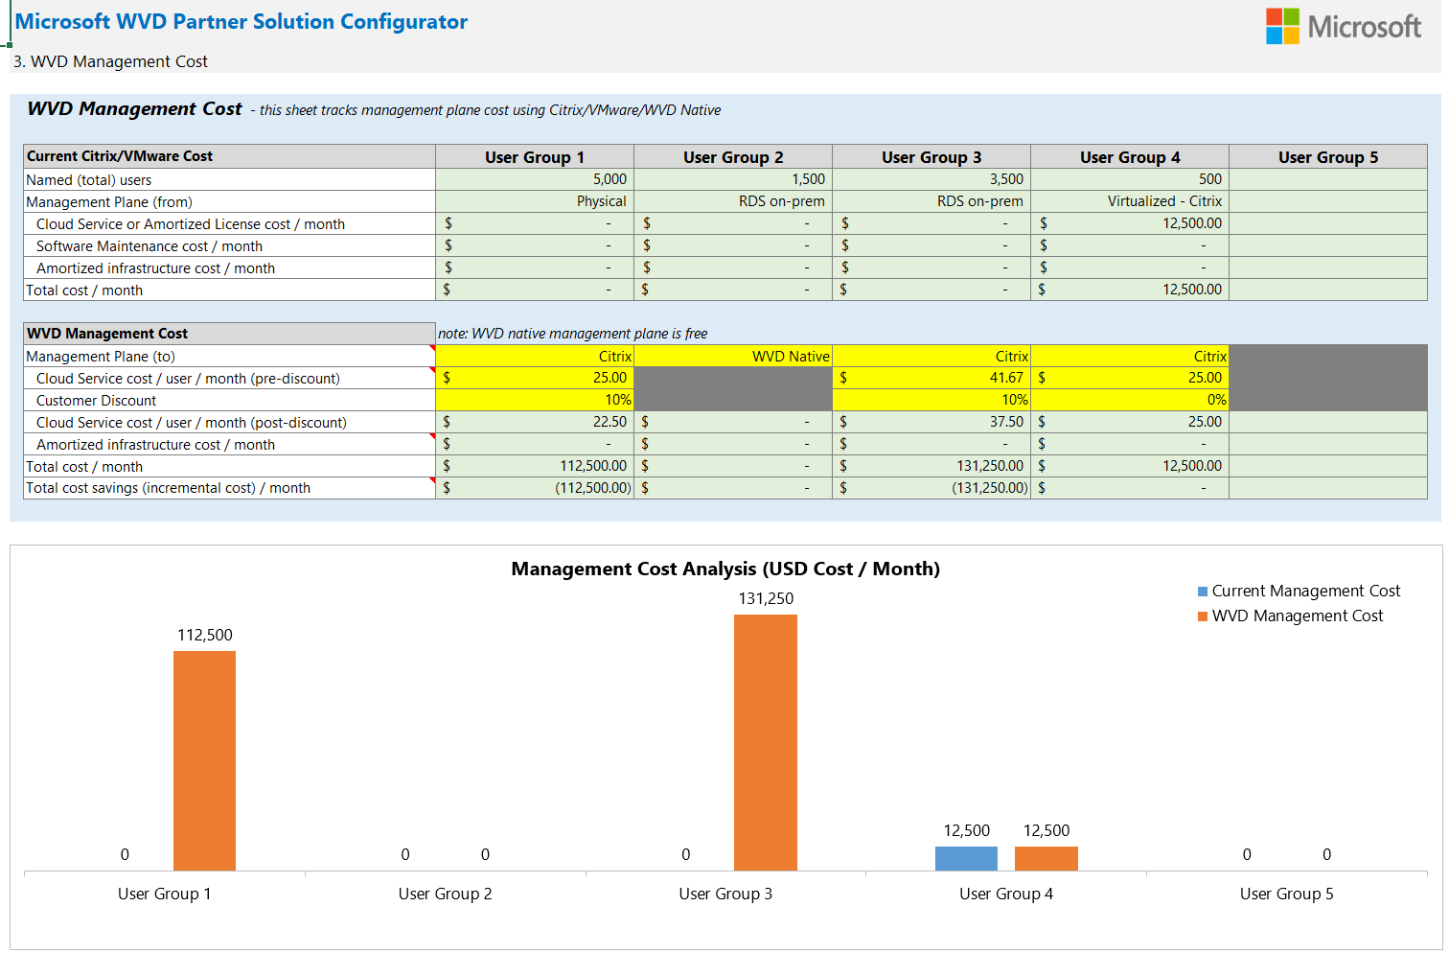


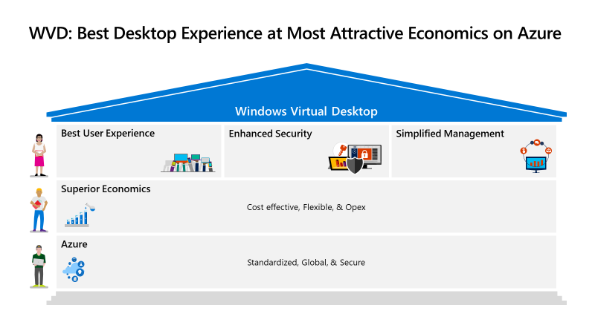
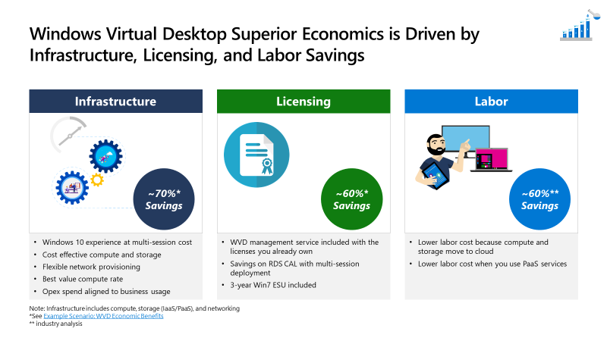
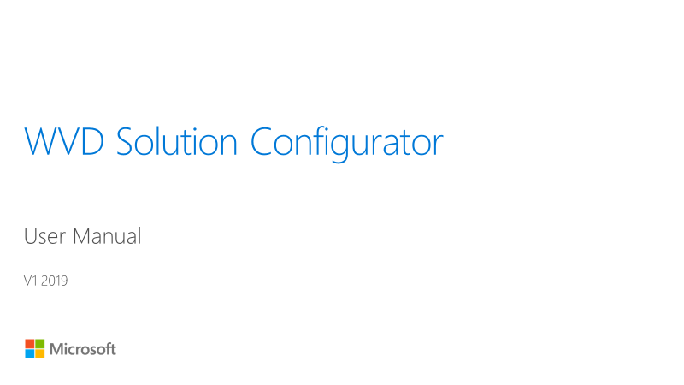

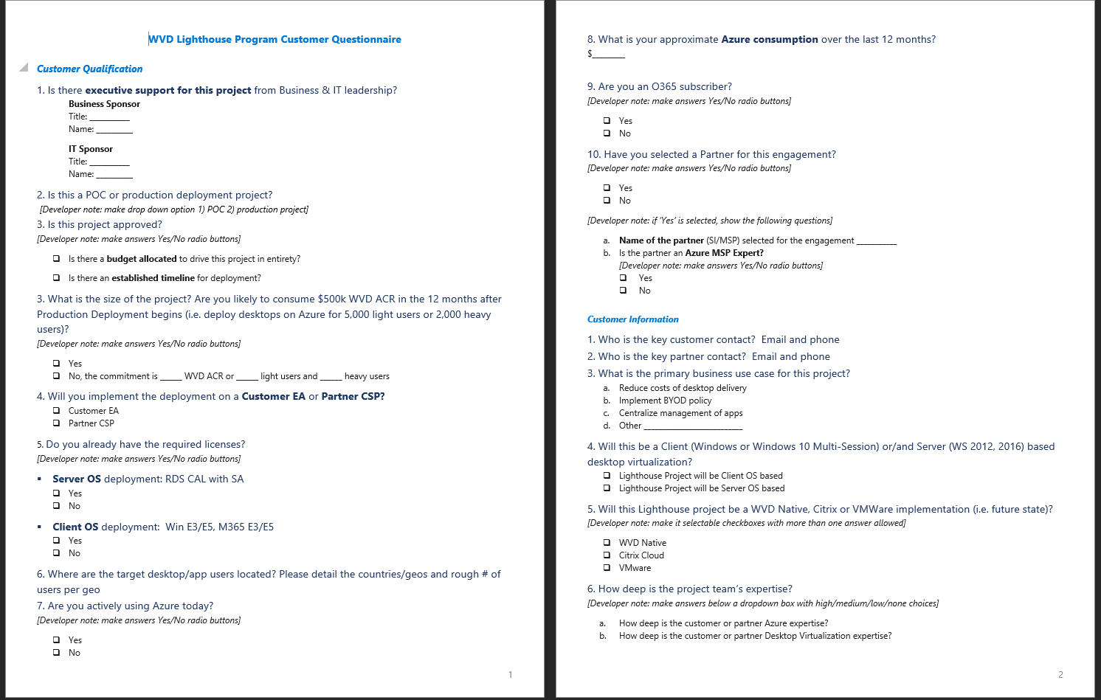




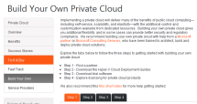
Partner Guide to IP
Customer discussion
Solution development
Solution deployment
Validate opportunity & identify sponsor
Develop customer requirements
Present solution
Demonstrate capability to exceed requirements
Negotiate & finalize contract
Finalize deployment, execute, & support
Customer Value Prop Presentation
Why WVD on Azure
Customer Cost Savings
Calculator + Solution Configurator
High-level economics model
Technical Presentation to review Pilot
WVD technical deployment guides
Customer Product check list
AWS Workspace Compete
WVD Technical FAQ, Design guide
License Cost Presentation
Deployment Guides / Azure Docs

Slide 11
Next Steps
Submit Nomination at : https://aka.ms/WVDLighthouseProgram Nominations need to made by a MSFT employee on behalf of partner and/or customer
Identify & Qualify Customer
Engage with Your CSA Account Team
Build Trial Customer Pipeline
Plan & Execute Pilots and Scale Deployments

Slide 12
THANK YOU

Slide 13
Appendix

Slide 14
WVD Lighthouse Program Goals and Design Principles
GOALS
DESIGN PRINCIPLES
Achieve Customer Wins
100+ Enterprise production pilot wins to lay a foundation for broad WVD customer adoption
Case studies from Marque customers in key industries
Strengthen Partner Ecosystem
Strong partner ecosystem to support WVD trial and adoption
Provide feedback to Engineering
Lighthouse customer feedback on product features and gaps
Learning from early customer adoption
Drive joint engagement motion with Citrix and VMWare
Solution win definition includes
WVD Native
Citrix Cloud + WVD
VMWare + WVD (coming in March 2020)
Customer Profile
Strategic, HiPo & Enterprise customers prioritized
Partner-led
Strong MSP/GSI eco-system of trained, capable partners who actively engage with customers in the Lighthouse Program
MSP Expert Partners preferred for customer deployments
Accelerated early adoption and feedback
Program phases and benefits (Trial → Production Pilot → Scale) map to customer journey
All program phases provide framework for capturing customer and partner feedback
Choice of customer management plane
Choice of WVD Native, Citrix Cloud + WVD, or VMWare + WVD management plane solution choice is based on customer needs Note : ACR is exactly the same irrespective of which management plan the customer chooses. WVD Native choice does not drive “extra” ACR

Slide 15
Lighthouse Program Details: Trial
MSFT Gives | Customer Gives
$250 Azure credits (valid for 2 months) Access to WVD Lighthouse Program technical forum | Enrollment into Lighthouse Program (Trial Phase) MSX ID with WVD tag (created by MSFT Field Sales Lead)
Trial
Production Pilot
Scale

Slide 16
Lighthouse Program Details: Production Pilot
MSFT Gives | Customer Gives
Additional Azure Credits Up to $1,500, valid for 3 months Customer Incentives If Customer enters into Agreement with MSP Azure Expert Partner, Microsoft will commit up to $30,000 If Customer enters into Agreement with non-MSP Azure Expert Partner, Microsoft will commit up to $20,000 Incentive funds will be approved once Microsoft receives a signed SoW between Customer and Partner with all conditions satisfied (contact your PDM for the process details) Incentive funds will be released to the Partner after receiving proof of successful execution. Note: Microsoft will verify MAU, and the incentive payment will be released only if the 25+ MAU success metric has been met. Access to tools: Lakeside, Liquidware Access to WVD Design and Deployment Helpdesk Access to WVD Lighthouse Program technical forum Monthly product update webinars from WVD engineering team | Enrollment into Lighthouse Program (Production Pilot Phase) Signed Production Pilot SOW with Partner Shows detailed scope of deployment work - date of SOW completion cannot be later than June 15, 2020. Stipulates at least 25+ MAU Recommended SOW pilot duration : ~3 months. Send a signed copy to Microsoft (via the Lighthouse Program site)
Trial
Production Pilot
Scale

Slide 17
Lighthouse Program Details: Scale
Customer must have WVD MAU > 25 to qualify for this phase
MSFT Gives | Customer Gives
Additional Azure Credits Up to $20,000, valid for 6 months Customer Incentives If Customer enters into Agreement with MSP Azure Expert Partner, Microsoft will commit up to $60,000 If Customer enters into Agreement with non-MSP Azure Expert Partner, Microsoft will commit up to $40,000 Incentive funds will be approved once Microsoft receives a signed SoW between Customer and Partner with all conditions satisfied (contact your PDM for the process details) Incentive funds will be released to the Partner after receiving proof of successful execution. Note: Microsoft will verify MAU, and the incentive payment will be released only if the 500+ MAU success metric has been met. Access to tools: Lakeside, Liquidware Access to WVD Design and Deployment Helpdesk Access to WVD Lighthouse Program technical forum WVD Global Blackbelt resource support Escalations to engineering team Early roadmap visibility and knowledge sharing with Engineering team Executive sponsorship within Microsoft | Enrollment into Lighthouse Program (Scale Phase) Signed SOW with Partner Shows detailed scope of deployment work Stipulates at least 500+ MAU SOW completion date for the WVD project date cannot be later than June 15, 2020. Send a signed copy to Microsoft (via the Lighthouse Program site)
Trial
Production Pilot
Scale

Slide 18
Trial is a low-risk approach to sell your customers on WVD idea
Trial
Checklist
START*
Use WVD Product Qualification Checklist to help customer make decision on Management plane
For strategic engagements, leverage local Microsoft’s WVD GBB team as appropriate
Leverage key resources including Solution Configurator tool, customer discussion guide, WVD technical FAQ. Pointer to WVD Azure docs, product checklist
NO
Target Customers & Pitch WVD
Build pipeline of qualified customers
Prioritize customers with existing virtualization deployments (i.e. Windows RDS, VDI, Citrix-based)
Pitch WVD
High customer
Interest to act?
Deprioritize opportunity
Have Microsoft Seller register customer engagement ID in MSX
YES
Evaluate Solution Definition
Decide on WVD native, Citrix Cloud+WVD or VMWare+WVD trial
Nomination Approved?
Have Microsoft Seller submit nomination on LH program site
NO
Seller will notify You
YES
Run Trial
Work with Microsoft Seller to ensure program benefits are allocated to Customer
CONTINUE
*Customer can enter Program in the beginning of every phase

Slide 19
Build a pilot solution for your Customer with MSFT’s programmatic help
Production Pilot
Production Pilot Checklist
START/ CONTINUE*
Trial Checklist ( prior page)
Work with customer to define scope of project. Review WVD SOW template as reference
Check for Production Pilot criteria (25+ MAU in production) as part of SOW
Work with Microsoft Seller to secure incentive funds
Qualify Customer for Production Pilot
Determine scope of Pilot, including appropriate business scenarios
Pilot objectives met?
Change Pilot scope and re-qualify
NO
YES
Align with Microsoft Seller on the Opportunity
Work with your PDM to learn how to align with a Microsoft Seller
Work with Microsoft Seller/Customer to ensure scope and success metric alignment
Sign SoW for WVD project with Customer
Nomination Approved?
Seller will notify You
Have Microsoft Seller submit nomination on LH program site
NO
YES
Run Production Pilot
Work with Microsoft Seller to ensure program benefits are allocated to Customer
Pilot success conditions met?
Conduct post mortem with Seller and decide on re-running pilot
NO
YES
CONTINUE
*Customer can enter Program in the beginning of every phase

Slide 20
Leverage MSFT’s programmatic benefits and scale up a WVD solution
Scale
Scale Checklist
START/ CONTINUE*
Production Pilot Checklist (prior page)
Check for Scale criteria (500+ MAU in production) as part of SOW
Work with Microsoft Seller to secure Scale incentive funds
Qualify Customer for Scale Deployment
Determine scope of Scale, including appropriate business scenarios
Scale objectives met?
Change scope and re-qualify
NO
Align with Microsoft Seller on the Opportunity
Work with your PDM to learn how to align with a Microsoft Seller
YES
Work with Microsoft Seller/Customer to ensure scope and success metric alignment
Sign SoW for WVD project with Customer
Have Microsoft Seller submit nomination on LH program site
Nomination Approved?
Seller will notify You
NO
YES
Scale success conditions met?
Conduct post mortem with Seller and decide on re-running deployment
Run Scale Deployment
Work with Microsoft Seller to ensure program benefits are allocated to Customer
NO
END
*Customer can enter Program in the beginning of every phase
YES

Slide 21
WVD Lighthouse Program FAQ
Question | Answer
How is Lighthouse Program partner centric? | Microsoft believes strongly that most WVD deployments require significant Partner expertise. Hence, the Lighthouse Program provides rich benefits to both Customer and Partner to make WVD solution a success. Microsoft is strongly committed to a robust partner ecosystem throughout WVD adoption.
Is Microsoft competing with Citrix & VMWare with WVD? | No. The choice of management plane (WVD Native, Citrix Cloud + WVD, VMware + WVD) should be decided based on customer needs.
Should I wait till WVD Service runs local in my customer’s Datacenter before engaging customers? | No. WVD will go GA across all geos on the same date – which means customers anywhere in the world can run their production solutions, open support cases via CSS etc. There will be a temporary latency for users in countries where the WVD service is not available in local DC. This temporary latency will go away as we roll out service in all regional DCs over 6+ months. Given the long deployment cycle of WVD POCs/Pilots – we need to start pilots ASAP. By the time, the customer is ready for scale production, the service will be available locally in most of the geos. EU will be available in October; Japan in December.
Why did Microsoft partner with Lakeside & Liquidware ? | Desktop/User application assessments are critical for WVD customer adoption. Lakeside provides a very robust desktop assessment solution (Systrack). Lakeside provides free licenses for WVD Lighthouse customers. In addition, Lakeside provides performance monitoring capabilities. User profile migration from on-premises ( UPD, Citrix UPM, Roaming profiles etc) to WVD/FSLogix is a critical piece of WVD deployment. Liquidware provides a robust tool (Profile Unity) to do these user profile migrations. Liquidware provides free licenses for WVD Lighthouse customers. In addition, Liquidware provides robust app layering solution capabilities.
How does ASR (Azure Site Recovery) tool fit in? | ASR is our primary tool of choice for VM migrations (different from user profile migrations described below) in WVD. ASR works for both Server and Client (Win 7, Win 10) migrations. Also, Disaster Recovery (DR) is a key customer use case for WVD.
What are the key use cases where WVD Native is NOT optimal – that Citrix/VMware + WVD can solve? | Customer wants a single management plane for managing hybrid solution ( On-premises + Cloud, WVD + AWS + GCP combination). WVD is an Azure solution. Customer has user applications that need Linux Server OS ( WVD Native will soon support Linux Clients via SDK) Citrix/VMware provide additional value-add on image management and device management that might be needed by some customers Note: Teams support on WVD Native coming soon.
Does Microsoft have a WVD GBB team? | Yes. Please work with Microsoft Seller to engage WVD GBBs on strategic deals where the customer has strong executive commitment to move forward.
What does the WVD Design and Deployment Helpdesk do? | WVD Design and Deployment Help Desk accelerates the time to market by providing deep technical support, answering questions on WVD design, architecture, and deployment. Please note product/service support is provided by CSS.
Who is the primary point of contact for the program for additional Q/A? | narena@microsoft.com

Slide 22
THANK YOU

